Slide 1

Introduction to XProc 3.0
The 19th ACM Symposium on Document Engineering
September 26-29 2019, Berlin

Slide 2
XProc?
XProc is an XML based programming language for complex data processing - pipelining
Extensible set of small, sharp tools for creating and transforming XML and other documents
V1.0 available (two processor implementations to run your pipelines)
Specification and implementation V3.0 under development
I’ll show where to find all this on the web in a few slides

Slide 3

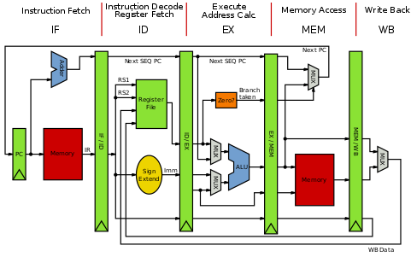

Why should I bother?
Pipelines are ubiquitous all around us
Solve problems with a set of small, sharp tools that combine in many ways
Like the UNIX command line
Very natural choice for document processing
Compose small tools into something bigger, pipelines…
XProc beats the alternatives
A successful example of large-scale application of XProc (1.0) pipelines doing document engineering:
https://www.le-tex.de/en/transpect.html

Slide 4
History and status 1
V1 (2010) turned out to be
hard to use and understand
verbose
Became outdated with respect to underlying standards
V2 Initiative (non-XML) – not enough support
And, besides, all the important XML standards used 3.x …
V3 Initiative (2016) - W3C Community Group
Stay close to existing syntax
Make language more usable, understandable and concise
Update underlying standards
Allow other document types to flow through
Clean up loose ends
Editors
Norman Walsh, Achim Berndzen, Gerrit Imsieke, Erik Siegel

Slide 5
History and status 2
Final call core spec
Working on the steps
Plan: End before end 2019
In the making:
A specification (http://spec.xproc.org)
Two processor implementations (XML Calabash, MorganaXProc)
A programmer's reference book
And its name is…
Kanava
Logo!
Thanks to Bethan Tovey

Slide 6

Who Am I?
Erik Siegel
Content Engineer and XML specialist
One-man company: Xatapult
Groningen, The Netherlands
Customer mostly in publishing and standardization
Part of the XProc 3.0 editing committee
Contact:
erik@xatapult.nl www.xatapult.com www.linkedin.com/in/esiegel/ +31 6 53260792

Slide 7
Links
XProc 1.0:
Specification: https://www.w3.org/TR/xproc/
XML Calabash processor: https://xmlcalabash.com/
Morgana XProc processor: https://www.xml-project.com/morganaxproc/
XProc 3.0:
Specification: http://spec.xproc.org/master/head/
Github: https://github.com/xproc/
W3C: https://www.w3.org/community/xproc-next/
Next meeting of the XProc 3.0 working group: November 9-10, Cologne. Feel free to join! (https://github.com/xproc/Workshop-2019-11)

Slide 8

Hands-on: Installation and pre-flight check
Go to https://github.com/eriksiegel/DocEng-2019-XProc/releases and download the latest release zip
Unzip this somewhere on your machine
JRE (V1.8.x works, maybe others too…) must be installed!
Open a command window in exercises/01-hello-xproc/
Try run.bat or run.sh
=================================
MorganaXProc-III 0.8.21-alpha
Copyright 2011-2019 by <xml-project /> Achim Berndzen
=================================
<hello-xproc timestamp="2019-08-22T11:37:55+01:00"/>
If it works you’ve just run your first XProc pipeline!

Slide 9
XProc fundamentals
You need to understand this!

Slide 10
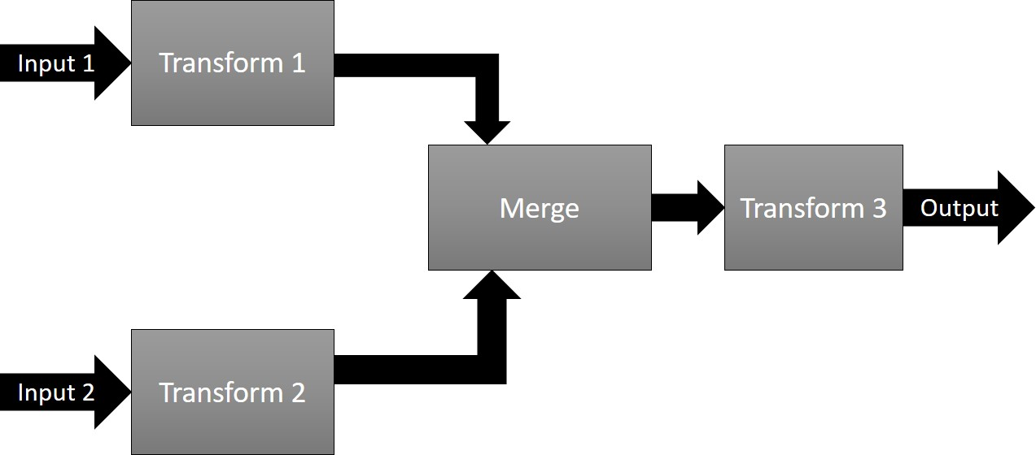
Pipelines, steps
Document(s) as input
Process the data flowing through using steps
Produce output(s)
Documents can be of any type, not just XML!

Slide 11
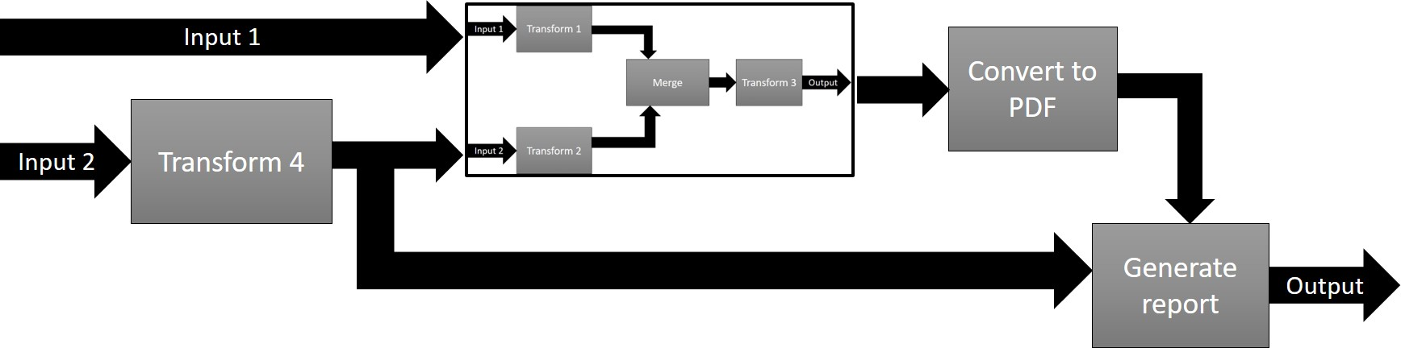
Pipelines, steps
In XProc, a pipeline and a step are essentially the same. The terms can be used interchangeably!

Slide 12
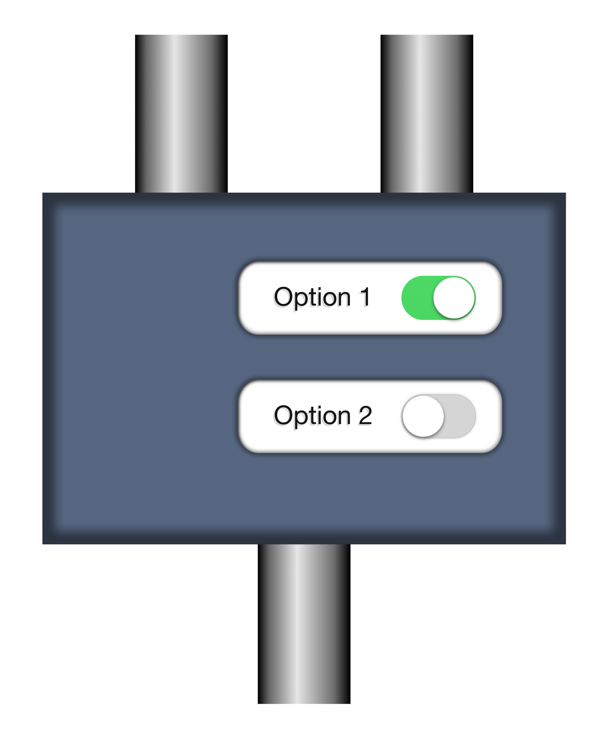
Steps/pipelines, ports, options
Step specification: http://spec.xproc.org/master/head/steps/#c.add-attribute
document
source
options
p:add-attribute
match
attribute-name
attribute-value
result
You can specify what types of documents are valid if you write a step of your own
Transformed document

Slide 13
Step/pipeline that adds an attribute - root
Namespace and preferred prefix (p:)
XProc version
<p:declare-step xmlns:p="http://www.w3.org/ns/xproc" version="3.0“
name="add-attribute-pipeline">
<p:input port="source"/>
<p:output port="result">
<p:pipe step="add-attribute-1" port="result"/>
</p:output>
<p:add-attribute name="add-attribute-1">
<p:with-input port="source">
<p:pipe step="add-attribute-pipeline" port="source"/>
</p:with-input>
<p:with-option name="match" select="'/*'"/>
<p:with-option name="attribute-name" select="'timestamp'"/>
<p:with-option name="attribute-value" select="current-dateTime()"/>
</p:add-attribute>
</p:declare-step>

Slide 14
Step/pipeline that adds an attribute - in/output ports
<p:declare-step xmlns:p="http://www.w3.org/ns/xproc" version="3.0“
name="add-attribute-pipeline">
<p:input port="source"/>
<p:output port="result">
<p:pipe step="add-attribute-1" port="result"/>
</p:output>
<p:add-attribute name="add-attribute-1">
<p:with-input port="source">
<p:pipe step="add-attribute-pipeline" port="source"/>
</p:with-input>
<p:with-option name="match" select="'/*'"/>
<p:with-option name="attribute-name" select="'timestamp'"/>
<p:with-option name="attribute-value" select="current-dateTime()"/>
</p:add-attribute>
</p:declare-step>
Input port
Output port
Emit the result of an output port of a step in this pipeline

Slide 15
Step/pipeline that adds an attribute - connect a port
<p:declare-step xmlns:p="http://www.w3.org/ns/xproc" version="3.0“
name="add-attribute-pipeline">
<p:input port="source"/>
<p:output port="result">
<p:pipe step="add-attribute-1" port="result"/>
</p:output>
<p:add-attribute name="add-attribute-1">
<p:with-input port="source">
<p:pipe step="add-attribute-pipeline" port="source"/>
</p:with-input>
<p:with-option name="match" select="'/*'"/>
<p:with-option name="attribute-name" select="'timestamp'"/>
<p:with-option name="attribute-value" select="current-dateTime()"/>
</p:add-attribute>
</p:declare-step>
Connect the source port of p:add-attribute to what flows into the encompassing step
Port connections are always defined on the input ports

Slide 16
Step/pipeline that adds an attribute - set options
<p:declare-step xmlns:p="http://www.w3.org/ns/xproc" version="3.0“
name="add-attribute-pipeline">
<p:input port="source"/>
<p:output port="result">
<p:pipe step="add-attribute-1" port="result"/>
</p:output>
<p:add-attribute name="add-attribute-1">
<p:with-input port="source">
<p:pipe step="add-attribute-pipeline" port="source"/>
</p:with-input>
<p:with-option name="match" select="'/*'"/>
<p:with-option name="attribute-name" select="'timestamp'"/>
<p:with-option name="attribute-value" select="current-dateTime()"/>
</p:add-attribute>
</p:declare-step>
Set the 3 options of p:add-attribute
XProc uses XPath 3.1 for all expressions, just like XSLT 3.0 and XQuery 3.1

Slide 17
Hands-on: Add a second attribute
Open a command window in exercises/02-add-attribute-1/
Try run.bat or run.sh.
The input comes from input.xml in the same directory
Change the pipeline and add a second p:attribute step that also adds an enabled=“true” attribute to the root element.
Connect the source port of your new p:attribute explicitly to the result port of the existing p:add-attribute.
Try it!
Whow, that’s a boring thing to do! I encourage you to experiment a bit …

Slide 18
Add a second attribute - solution
<p:declare-step xmlns:p="http://www.w3.org/ns/xproc" version="3.0“
name="add-attribute-pipeline">
<p:input port="source"/>
<p:output port="result">
<p:pipe step="add-attribute-2" port="result"/>
</p:output>
<p:add-attribute name="add-attribute-1">
…
</p:add-attribute>
<p:add-attribute name="add-attribute-2">
<p:with-input port="source">
<p:pipe step="add-attribute-1" port="result"/>
</p:with-input>
<p:with-option name="match" select="'/*'"/>
<p:with-option name="attribute-name" select="'enabled'"/>
<p:with-option name="attribute-value" select="true()"/>
</p:add-attribute>
</p:declare-step>
Get the final result from the new p:add-attribute
Read from the result port of the first p:add-attribute
Awkward and verbose. I don’t like it!

Slide 19
Connect ports using the pipe attribute
<p:declare-step xmlns:p="http://www.w3.org/ns/xproc" version="3.0" name="add-attribute-pipeline">
<p:input port="source"/>
<p:output port="result" pipe="result@add-attribute-1"/>
<p:add-attribute name="add-attribute-1">
<p:with-input port="source" pipe="source@add-attribute-pipeline"/>
<p:with-option name="match" select="'/*'"/>
<p:with-option name="attribute-name" select="'timestamp'"/>
<p:with-option name="attribute-value" select="current-dateTime()"/>
</p:add-attribute>
</p:declare-step>
Use a shorthand pipe=“port@step” notation
Same here

Slide 20
Hands-on: Add a second attribute using the pipe attribute
Open a command window in exercises/03-add-attribute-2/
Try run.bat or run.sh.
Change the pipeline and add a second p:attribute step that also adds an enabled=“true” attribute to the root element.
Connect the source port of your new p:attribute explicitly to the result port of the existing p:add-attribute using a pipe attribute.
Try it!

Slide 21
Add a second attribute using the pipe attribute - solution
<p:declare-step xmlns:p="http://www.w3.org/ns/xproc" version="3.0" name="add-attribute-pipeline">
<p:input port="source"/>
<p:output port="result" pipe="result@add-attribute-2"/>
<p:add-attribute name="add-attribute-1">
<p:with-input port="source" pipe="source@add-attribute-pipeline"/>
<p:with-option name="match" select="'/*'"/>
<p:with-option name="attribute-name" select="'timestamp'"/>
<p:with-option name="attribute-value" select="current-dateTime()"/>
</p:add-attribute>
<p:add-attribute name="add-attribute-2">
<p:with-input port="source" pipe="result@add-attribute-1"/>
<p:with-option name="match" select="'/*'"/>
<p:with-option name="attribute-name" select="'enabled'"/>
<p:with-option name="attribute-value" select="true()"/>
</p:add-attribute>
</p:declare-step>
Better, shorter, but still…
Why would I need to explicitly connect ports at all if its clear that they should connect anyway?

Slide 22
Primary ports
source
Primary ports
p:something
result
The port names source and result for the primary ports are a convention
Not all ports are created equal…

Slide 23
Primary ports, implicit connections
source
p:something
Click!
result
source
Primary ports implicitly connect
p:something
Think of primary ports having little magnets that snap automagically together
result

Slide 24
Primary ports, implicit connections
If a step has only a single input or output port, they’re primary by default. But you can set the primary status explicitly using a primary=“true/false” attribute here.
<p:declare-step … >
<p:input port="source"/>
<p:output port="result"/>
<p:add-attribute>
…
</p:add-attribute>
<p:add-attribute >
…
</p:add-attribute >
</p:declare-step>
Implicit connection of
primary input port to first step
Implicit connection of last step to primary output port
Implicit connection of steps

Slide 25
Connect ports implicitly
<p:declare-step xmlns:p="http://www.w3.org/ns/xproc" version="3.0">
<p:input port="source"/>
<p:output port="result"/>
<p:add-attribute>
<p:with-option name="match" select="'/*'"/>
<p:with-option name="attribute-name" select="'timestamp'"/>
<p:with-option name="attribute-value" select="current-dateTime()"/>
</p:add-attribute>
</p:declare-step>
Huh? Where are the name attributes?

Slide 26
Hands-on: Add a second attribute using implicit connections
Open a command window in exercises/04-add-attribute-3/
Try run.bat or run.sh.
Change the pipeline and add a second p:attribute step that also adds an enabled=“true” attribute to the root element.
Use the primary ports implicit connections
Try it!

Slide 27
Connect ports implicitly - solution
<p:declare-step xmlns:p="http://www.w3.org/ns/xproc" version="3.0">
<p:input port="source"/>
<p:output port="result"/>
<p:add-attribute>
<p:with-option name="match" select="'/*'"/>
<p:with-option name="attribute-name" select="'timestamp'"/>
<p:with-option name="attribute-value" select="current-dateTime()"/>
</p:add-attribute>
<p:add-attribute>
<p:with-option name="match" select="'/*'"/>
<p:with-option name="attribute-name" select="'enabled'"/>
<p:with-option name="attribute-value" select="true()"/>
</p:add-attribute>
</p:declare-step>
It’s getting better. But can’t we make it a tad more concise still?

Slide 28
Setting options using attributes
<p:declare-step xmlns:p="http://www.w3.org/ns/xproc" version="3.0">
<p:input port="source"/>
<p:output port="result"/>
<p:add-attribute match="/*" attribute-name="timestamp"
attribute-value="{current-dateTime()}"/>
</p:declare-step>
You can specify option values as attributes on the step invocation
To compute stuff use Attribute-Value-Templates (AVTs), just like in XSLT.

Slide 29
Hands-on: Add a second attribute using option values set by attributes
Open a command window in exercises/05-add-attribute-4/
Try run.bat or run.sh.
Change the pipeline and add a second p:attribute step that also adds an enabled=“true” attribute to the root element.
Set all the options by attributes
Try it!
Zzzzzzzz……
All that attribute adding is so boring, time to move on!

Slide 30
Set options using attributes - solution
<p:declare-step xmlns:p="http://www.w3.org/ns/xproc" version="3.0">
<p:input port="source"/>
<p:output port="result"/>
<p:add-attribute match="/*" attribute-name="timestamp"
attribute-value="{current-dateTime()}"/>
<p:add-attribute match="/*" attribute-name="enabled"
attribute-value="true"/>
</p:declare-step>
Short, concise and intuitively clear. That’s how I like it!

Slide 31
Intermezzo 1: Your own options
We’ve seen that built-in steps can have options
match
attribute-name
attribute-value
What if you want to add an option to your own step?
<p:declare-step xmlns:p="http://www.w3.org/ns/xproc" version="3.0">
<p:input port="source"/>
<p:output port="result"/>
<p:option name=“username"/>
<p:add-attribute match="/*" attribute-name=“username"
attribute-value="{upper-case($username)}"/>
</p:declare-step>
Declare the option in the prolog of your step
You can make an option required, set a datatype, supply a default, etc.
Reference the option using the $... notation, just like XSLT and XQuery
See: exercises/06-own-option/

Slide 32
Intermezzo 2: Variables
<p:declare-step xmlns:p="http://www.w3.org/ns/xproc" version="3.0">
<p:input port="source"/>
<p:output port="result"/>
<p:option name="username"/>
<p:variable name="id" select="upper-case($username) || '-' ||
p:system-property('p:episode')" />
<p:add-attribute match="/*" attribute-name="id" attribute-value="{$id}"/>
</p:declare-step>
Declare the variable anywhere
Reference the variable using the $... notation, just like XSLT and XQuery
Variables can be of any datatype, just like in XSLT or XQuery
See: exercises/07-variables/

Slide 33
Intermezzo 2: Variables
Read values from the document flowing through!
<p:variable name="status" select="/*/@status" />
You can even base its value on something flowing from another output port

Slide 34
The p:insert step
See: http://spec.xproc.org/master/head/steps/#c.insert
Base
document
Document to insert
source
insertion
options
p:insert
match
position
result
Possible values for position:
first-child
last-child
before
after
The source and result port are primary, the insertion port is not…
Combined document

Slide 35
Connect a port to an inline document
In most cases you can leave out the <p:inline> wrapper
<p:some-step ...>
<p:with-input port="port-name">
<p:inline>
... (inline document) ...
</p:inline>
</p:with-input>
...
</p:some-step>
You can use expressions between curly braces {…} in your inline document
Expressions between curly braces are called TVTs (Text-Value-Templates and AVTs (Attribute-Value-Templates)

Slide 36
Hands-on: Add an additional child element using an inline document
Open a command window in exercises/08-connect-inline/
Finish the pipeline so it adds a <location>Berlin 2019</location> element after the <presenter> element.
Use the p:insert step
Use a <p:inline> wrapper
Compute the current year using a {…} construction
XPath cheat: year-from-date(current-date())
Try it with run.bat or run.sh
Remove the <p:inline> wrapper and try again. Any differences?
Now you’re on your own writing XProc, scary…

Slide 37
Connect a port to an external document
In most cases you can put the href attribute directly on the <p:with-input>, no need for a <p:document> then!
<p:some-step ...>
<p:with-input port="port-name">
<p:document href="reference-to-document"/>
</p:with-input>
...
</p:some-step>
The href attribute is an AVT: You can use expressions between curly braces {…} inside
We have no means to add the current year, like we did in the last exercise…

Slide 38
Hands-on: Add an additional child element using an external document
Open a command window in exercises/09-connect-external/
Finish the pipeline so it adds a <location>Berlin</location> element after the <presenter> element.
Use the p:insert step
Use a <p:document> element
Try it with run.bat or run.sh
Put the href attribute directly on the <p:with-input> Any differences?
Can you add a variable with the name of the file and use that to reference it?

Slide 39
Intermezzo: Documents flowing through
Native document types:
XML
HTML
JSON
Text
Other
All documents carry an adaptable properties map
Document
Representation
Properties:
Name | Value
content-type | application/xml
base-uri | file:///C:/data/doc.xml
… | …
Flow
It is also possible to work with multiple documents or none at all.

Slide 40
Intermezzo: The core (or compound) steps
p:for-each
p:choose / p:when / p:otherwise
p:if
p:viewport
p:try / p:catch
p:group
Regrettably there is no time to look at them all…

Slide 41
Use p:for-each to split a document
Split this in multiple documents
<documents>
<doc filename="output1.xml">
<contents>This is document number 1</contents>
</doc>
<doc filename="output2.xml">
<contents>This is document number 2</contents>
<more>It has some more...</more>
</doc>
</documents>
The filenames are in filename attibutes
Boring contents Erik

Slide 42
TBD?!?
Introduce the p:insert and the extra port
Introduce ways to connect this port:
To something on disk
To a literal
Document types
Properties?
Compound steps (for-each for instance, or viewport)

Slide 43

Documents flowing through (1.0)
<doc>
…
</doc>
Flow
1.0: Only XML documents

Slide 44
Steps, ports, options (1.0 & 3.0)
document
stylesheet
Base
document
Document to insert
source
stylesheet
options
source
insertion
options
p:xslt
parameters
p:insert
match
position
result
secondary
result
Transformed document
Additional documents
Combined document

Slide 45


Explicitly connecting ports (3.0)
<p:xslt>
<p:with-input port="stylesheet">
…
</p:with-input>
</p:xslt>
source
stylesheet
p:xslt
<p:input> ➔ <p:with-input>
result
secondary
Rules:
Input ports must be connected (or have a default)
Output ports can be left dangling (also primary output ports)

Slide 46
Explicitly connecting ports – with an external document (1.0 & 3.0)
/some/stylesheet.xsl
stylesheet
source
stylesheet
<p:xslt>
<p:with-input port="stylesheet">
<p:document href="/some/stylesheet.xsl"/>
</p:with-input>
</p:xslt>
p:xslt
result
secondary
1.0: You had to use <p:document> and @href had to be a literal

Slide 47
Explicitly connecting ports (3.0)
/some/stylesheet.xsl
stylesheet
source
stylesheet
<p:variable name="path" select="'/some'"/>
<p:xslt>
<p:with-input port="stylesheet">
<p:document href="{$path}/stylesheet.xsl"/>
</p:with-input>
</p:xslt>
p:xslt
result
secondary
Attribute-Value Templates

Slide 48
Explicitly connecting ports (3.0)
/some/stylesheet.xsl
stylesheet
source
stylesheet
<p:xslt>
<p:with-input port="stylesheet"
href="{$path}/stylesheet.xsl"/>
</p:xslt>
p:xslt
result
secondary
<p:document> can be shortened to a @href (just one example of lots of syntactic sugar shortcuts)

Slide 49
Explicitly connecting ports – to an inline document (1.0 & 3.0)
<p:xslt>
<p:with-input port="stylesheet">
<p:inline>
<xsl:stylesheet …>
…
</xsl:stylesheet>
</p:inline>
</p:with-input>
</p:xslt>
source
stylesheet
p:xslt
result
secondary
1.0: You had to use <p:inline>

Slide 50
Explicitly connecting ports – to an inline document (3.0)
<p:with-input port="source">
<root date="{current-date()}">
{$contents}
</root>
</p:with-input>
<p:xslt>
<p:with-input port="stylesheet">
<xsl:stylesheet …>
…
</xsl:stylesheet>
</p:with-input>
</p:xslt>
Inline documents can contain Text- and Attribute-Value Templates
source
stylesheet
p:xslt
result
secondary
<p:inline> no longer necessary (in most cases)

Slide 51
Explicitly connecting ports – to an output port of another step (1.0 & 3.0)
…
name="other-step"
<p:xslt>
<p:with-input port="stylesheet">
<p:pipe step="other-step"
port="port-name"/>
</p:with-input>
</p:xslt>
port-name
source
stylesheet
p:xslt
1.0: You had to use <p:pipe>
result
secondary

Slide 52
Explicitly connecting ports – to an output port of another step (3.0)
<p:xslt>
<p:with-input port="stylesheet"
pipe="port-name@other-step"/>
</p:xslt>
…
name="other-step"
port-name
<p:pipe> can be shortened to @pipe
source
stylesheet
p:xslt
result
secondary

Slide 53
Setting step parameters (1.0)
<xsl:param name="title"/>
<xsl:param name="heading-level"/>
<p:xslt>
…
<p:with-param name="title" select="'bla bla bla'"/>
<p:with-param name="heading-level" select="2"/>
</p:xslt>
1.0: You had to use <p:with-param> or parameter ports

Slide 54
Setting step parameters
<xsl:param name="title"/>
<xsl:param name="heading-level"/>
<p:xslt>
…
<p:with-option name="parameters" select="
map{ 'title': 'bla bla bla',
'heading-level': 2
}
"/>
</p:xslt>
Pass parameters in a map
XPath 3.1 support

Slide 55
Variables (1.0)
<p:variable name="path" select="/*/@path"/>
1.0: String only
1.0: Only at the top of a sub-pipeline
<p:group>
<p:variable name="…" select="…"/>
…
</p:group

Slide 56
Variables (3.0)
<p:variable name="path" as="xs:string" select="/*/@path"/>
<p:variable name="debug" as="xs:boolean" select="true()"/>
<p:variable name="mymap" as="map(*)" select="map{ … }"/>
XDM support and strong typing
Static variables
@use-when expressions
Constants for setting up the pipeline
Constants in libraries
Variables anywhere

Slide 57

Structure (1.0 & 3.0)
<p:for-each>
<p:iteration-source>
<p:choose> / <p:when> / <p:otherwise>
<p:if>
<p:viewport>
<p:group>
<p:try> / <p:catch>*

Slide 58
Crash Course XProc fundamentals - end

Slide 59



Slide 60
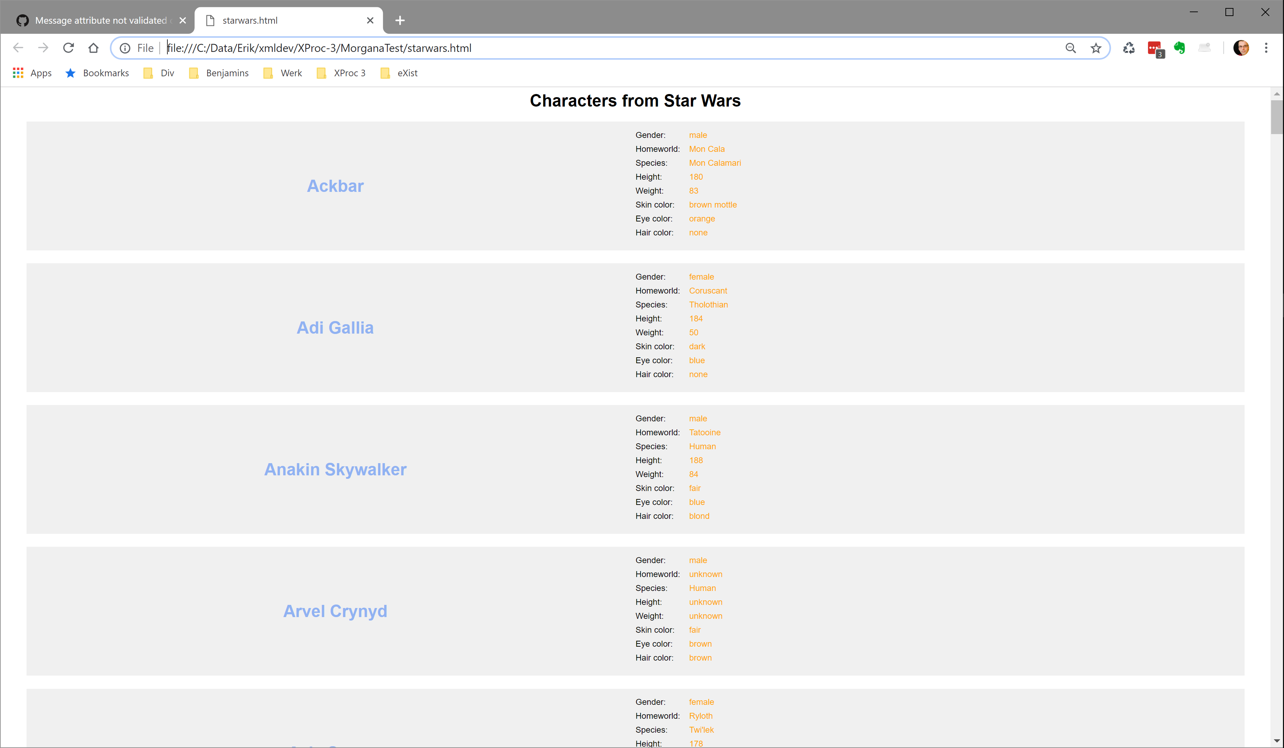

MorganaXProc meets Star Wars using JSON
https://swapi.co/api
JSON
XProc 3 pipeline
Runs on MorganaXProc 0.8.5-alpha

Slide 61
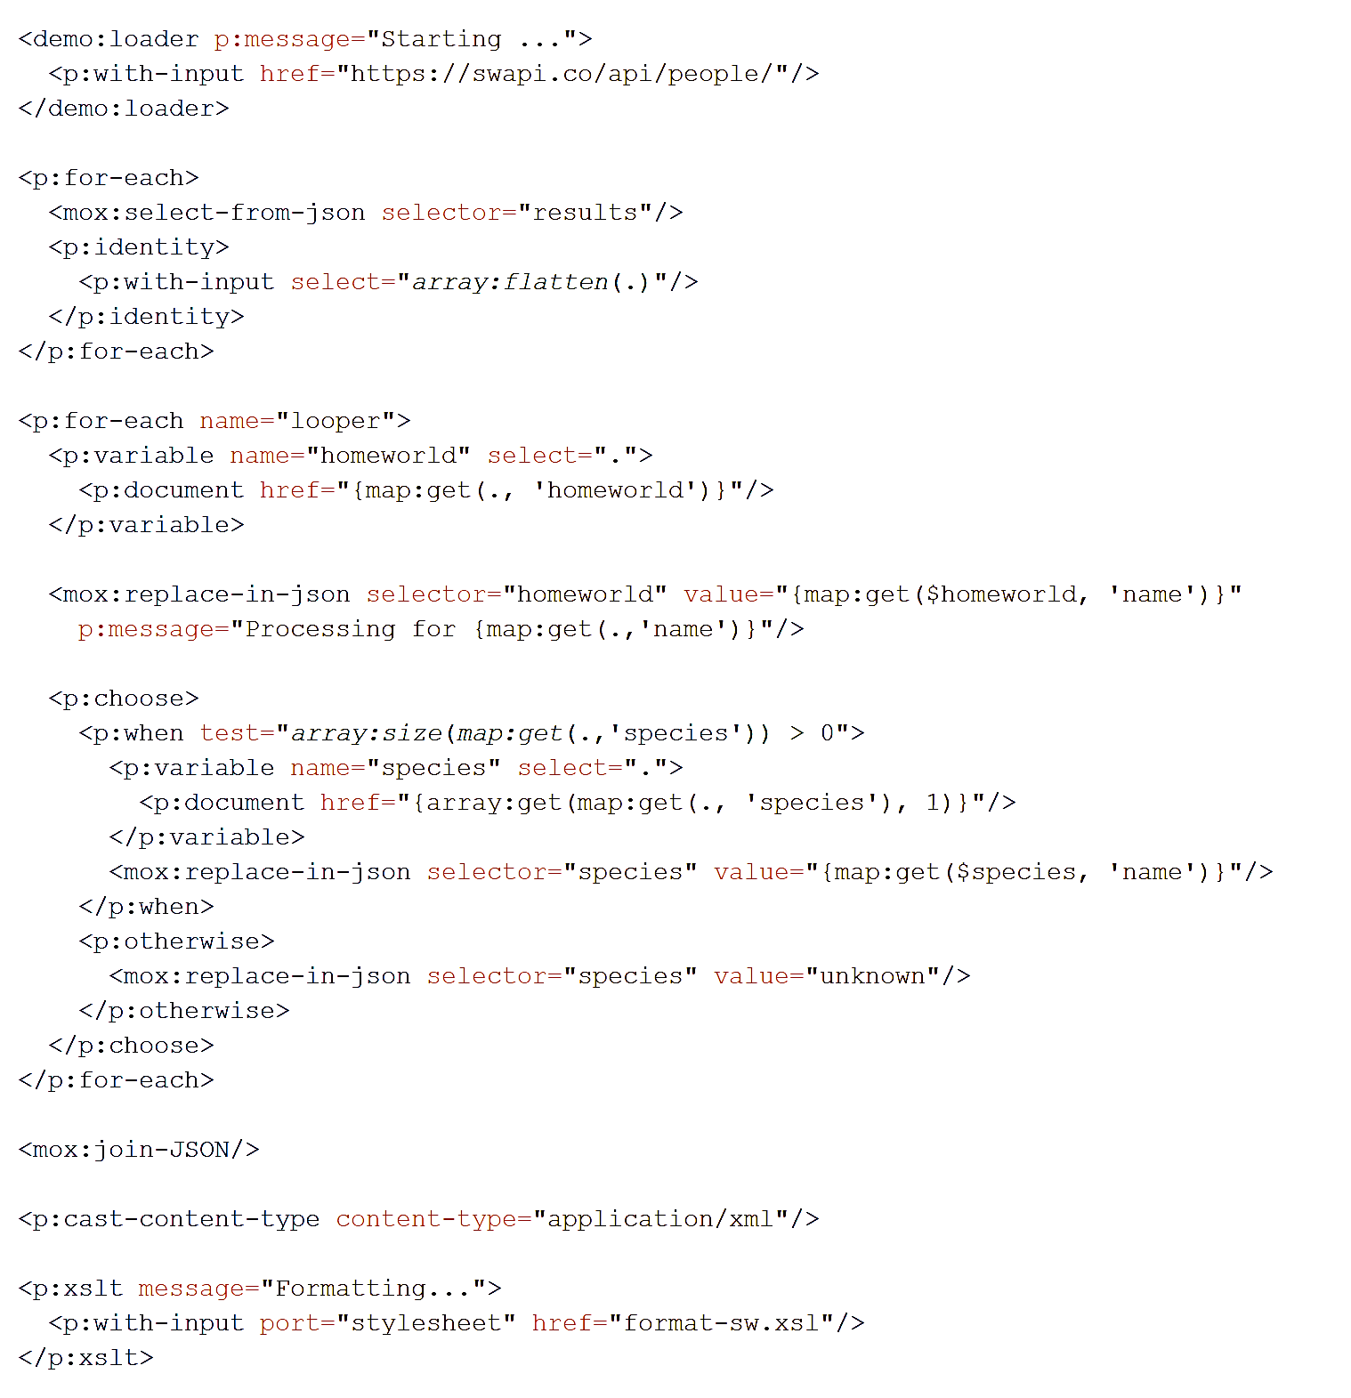
Native JSON
Convert JSON to XML
XML

Slide 62
Wrap up
XProc 3.0 is a more concise and easier-to-use version than 1.0
Updated underlying standards
Support for non-XML documents
Lots of syntactic sugar
Value templating {…}
You can help us:
By joining the discussions
By reviewing the specification
Processors and learning materials are on their way

Slide 63
XProc 3.0
Specification: http://spec.xproc.org/master/head/
XProc on github: https://github.com/xproc/
XProc on W3C: https://www.w3.org/community/xproc-next/
Use the issues list on github
Contact: xproc-dev@w3.org

Slide 64
The step library
Standard steps:
See: http://spec.xproc.org/master/head/steps/
Must be supported by every XProc 3.0 compliant processor
Lots of XML related steps, some text, some JSON
Additional optional step specifications
See: http://spec.xproc.org/master/head/#steps
Validation, OS, file handling, etc.

